Slide 1
Employee Data Analysis using Excel
STUDENT NAME: g. Vinoth
REGISTER NO :unm110312201294 ,a3566b6623152f7bd114640ed4e7afa5
DEPARTMENT : B.COM
COLLEG : DRBCCC HINDU COLLEGE

Slide 2
PROJECT TITLE :
Employee Performance Analysis using Excel

Slide 3
AGENDA :
Problem Statement
Project Overview
End Users
Our Solution and Proposition
Dataset Description
Modelling Approach
Results and Discussion
Conclusion

Slide 4

PROBLEM STATEMENT :
Organizations often struggle with the consistent evaluation of employee performance and the identification of areas needing improvement. Manual analysis can be both time-consuming and susceptible to bias, which can lead to inaccurate assessments. Implementing an automated, data-driven approach addresses these challenges by offering a more objective and efficient way to generate actionable insights, ultimately leading to more informed decision-making and better overall performance management.

Slide 5

PROJECT OVERVIEW :
This project is dedicated to a comprehensive analysis of employee performance data using a variety of Excel tools. The primary objective is to identify and understand trends within the data, highlight key performance indicators (KPIs), and uncover insights that can significantly enhance HR management practices. By systematically analyzing performance metrics, this project aims to provide valuable, data-driven insights that will aid in optimizing workforce management, improving decision-making processes, and ultimately contributing to the overall effectiveness and efficiency of the organization’s human resource strategies.

Slide 6
WHO ARE THE END USERS?
The primary users of this analysis include HR managers, department heads, and company executives, all of whom stand to gain significantly from the insights it offers. For HR managers, the analysis provides a clearer understanding of employee performance, enabling them to design more effective development programs and strategies for talent retention. Department heads benefit by gaining a detailed view of their teams’ strengths and areas that need improvement, which aids in making more precise decisions regarding resource allocation and team management. Company executives, on the other hand, can use the insights to guide strategic planning and performance management at an organizational level, ensuring that overall goals are met more efficiently. In essence, this analysis equips these key stakeholders with the data-driven insights necessary to make better, more informed decisions that drive both individual and organizational success.

Slide 7
OUR SOLUTION AND ITS VALUE PROPOSITION :
By analyzing historical performance data, we can pinpoint high and low performers, determine the impact of various factors on performance, and identify opportunities for improvement. This results in more effective management strategies and a data-driven approach to employee evaluation Step using in excel: Conditional formatting -To find out the missing features. Filter-To remove the blank data.
Steps Used in Excel:
Conditional Formatting: This tool was employed to quickly identify missing or incomplete data within the dataset. By highlighting these gaps, it ensured that all critical information was accounted for before proceeding with the analysis.
Filter: Filters were applied to the dataset to remove any blank or irrelevant data. This step was crucial for cleaning the data, ensuring that the analysis was conducted on a comprehensive and accurate dataset, free from any inconsistencies that could skew the results.
Formula: the formula we used to find the employee’s performance level:
This formula classified employees into distinct performance categories such as "Very High," "High," "Medium," and "Low" based on their numerical performance scores.

Slide 8
DATASET DESCRIPTION :
Employee Dataset = Kaggle
26 – Features
8 – Features
Employee id-Numerical
Employee Name –Text
Department –Text
Performance Rating – Numerical
Performance Score – Numerical
Gender –Male Female

Slide 9
THE "WOW" IN OUR SOLUTION :
Custom formulas were crafted to categorize employee performance into distinct levels such as "Very High," "High," "Medium," and "Low."
Formula : =IFS(Z2>=5,"VERY HIGH",Z2>=4,"HIGH",Z2>=3,"MED",TRUE,"LOW")
The IFS function in Excel, which returns a value based on the first condition that evaluates to TRUE. Your formula categorizes values in cell Z2 into "VERY HIGH," "HIGH," "MED," or "LOW" based on specific thresholds.
How the formula works:
If the value in Z2 is greater than or equal to 5, it returns "VERY HIGH."
If the value in Z2 is between 4 (inclusive) and 5, it returns "HIGH."
If the value in Z2 is between 3 (inclusive) and 4, it returns "MED."
If none of the above conditions are met, it returns "LOW."

Slide 10
MODELLING :
* Excel tools, such as pivot tables, charts, and conditional formatting, were effectively utilized to categorize performance data, visualize trends, and uncover patterns within the dataset. By leveraging these tools, key metrics were not only derived but also systematically grouped to emphasize critical areas of interest and concern.
*The analysis successfully identified significant trends, including variations in performance across different departments, the identification of top-performing individuals, and the recognition of areas that may require additional development and attention. The use of charts and data visualizations played a pivotal role in providing a clear and comprehensive view of the overall performance landscape, making it easier to pinpoint specific areas for improvement and celebrate areas of success.

Slide 11
Excel Tools Utilized:
Conditional Formatting: This tool was used to emphasize critical data points, such as varying levels of performance, to identify any missing or incomplete data, and to visually clarify emerging trends. By applying different color codes and rules, conditional formatting made it easier to spot important patterns and outliers within the dataset.
Filters: Filters were strategically applied to the dataset to eliminate incomplete or irrelevant data. This step was crucial in ensuring that the analysis was based on clean and accurate data, free from any noise that could potentially skew the results.
Formulas: Custom formulas were crafted to categorize employee performance into distinct levels such as "Very High," "High," "Medium," and "Low." For example, the formula =IFS(Z2>=5,"VERY HIGH",Z2>=4,"HIGH",Z2>=3,"MED",TRUE,"LOW")was utilized to automatically assign a performance label based on specific numerical values. This automated approach streamlined the process of classification, making it both efficient and consistent.
Pivot Tables: Pivot tables were employed to summarize and organize the data by key categories, such as department and performance level. This allowed for a more structured view of the dataset, facilitating easier extraction of insights and enabling a deeper understanding of performance trends across various segments.
Graphs and Charts: Various visual representations, including bar charts and pie charts, were generated to depict trends and illustrate the distribution of performance across different groups. These visual tools were instrumental in conveying the analysis in a clear and impactful manner, allowing stakeholders to quickly grasp the overall performance landscape and make informed decisions.

Slide 12
2. Steps Involved in Modeling:
Data Cleaning: The initial step involved meticulously filtering and cleaning the dataset to remove any missing, incorrect, or irrelevant entries. This critical process ensured that the analysis was conducted on accurate and reliable data, which is essential for producing meaningful insights and avoiding any potential distortions in the results.
Performance Categorization: Following the data cleaning, employee performance scores were systematically categorized using custom formulas. These formulas assigned labels such as "Very High," "High," "Medium," or "Low" to each employee's performance, based on predetermined numerical thresholds. This categorization facilitated a structured analysis, enabling a clearer understanding of performance distribution within the organization.
Trend Analysis: Pivot tables and charts were then employed to perform an in-depth trend analysis. This step focused on identifying patterns and variations in performance across various dimensions, such as different departments and gender-based trends. By segmenting the data in this way, the analysis was able to uncover valuable insights that might have otherwise remained hidden.
Visualization: The final step in the modeling process involved creating visual representations of the data through charts and graphs. These visuals were designed to present the findings in a clear, concise, and visually appealing manner, making it easier for decision-makers to quickly understand the key insights and take appropriate actions based on the analysis.

Slide 13
3. Outcome of the Modeling Approach:
Revealed Trends: The modeling approach successfully uncovered several significant trends. For instance, it was found that departments like Engineering and Finance had a higher proportion of high performers compared to other areas. This highlighted the departments that were excelling in terms of employee performance.
Departmental Performance Variations: The analysis also revealed notable variations in performance across different departments, providing a detailed understanding of how different segments within the organization were performing.
Actionable Insights: The insights derived from this analysis offer HR and management valuable guidance on where to focus their efforts for improvement. By identifying specific areas that require attention, the organization can implement targeted strategies to enhance overall performance management, ultimately leading to improved productivity and effectiveness.

Slide 14
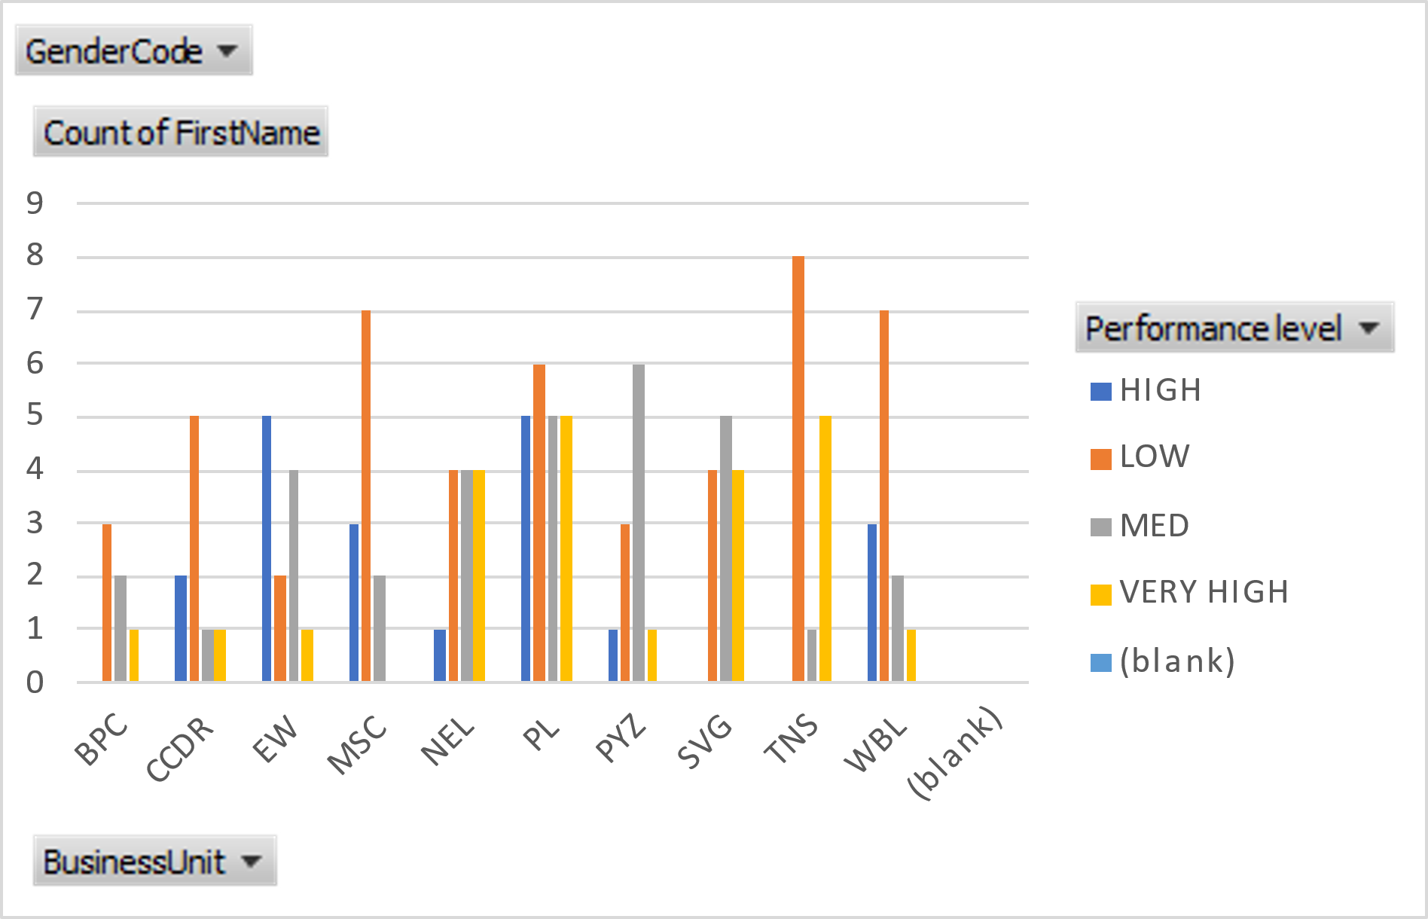
RESULTS :
*Graph *Pivot table
Performance analysis

Slide 15
PIVOT TABLE:
GenderCode | (All)
Count of FirstName | Column Labels
Row Labels | HIGH | LOW | MED | VERY HIGH | (blank) | Grand Total
BPC |  | 3 | 2 | 1 |  | 6
CCDR | 2 | 5 | 1 | 1 |  | 9
EW | 5 | 2 | 4 | 1 |  | 12
MSC | 3 | 7 | 2 |  |  | 12
NEL | 1 | 4 | 4 | 4 |  | 13
PL | 5 | 6 | 5 | 5 |  | 21
PYZ | 1 | 3 | 6 | 1 |  | 11
SVG |  | 4 | 5 | 4 |  | 13
TNS |  | 8 | 1 | 5 |  | 14
WBL | 3 | 7 | 2 | 1 |  | 13
(blank)
Grand Total | 20 | 49 | 32 | 23 |  | 124
The results slide presents the findings from the analysis, using a pivot table to show the distribution of employee performance across various categories (e.g., HIGH, LOW, MEDIUM, VERY HIGH) within different departments or groups. For example, the group "BPC" has 11 employees with "HIGH" performance, 16 with "LOW", etc. This slide visualizes the data to identify trends, such as which departments have more high-performing employees or which areas might need improvement.

Slide 16
Conclusion :
In conclusion, this analysis highlights the crucial role that data-driven performance evaluation plays in modern organizations. By effectively leveraging Excel as the tool for this analysis, a wealth of actionable insights was uncovered. These insights have not only empowered organizations to enhance their productivity but also enabled them to make more informed decisions regarding the optimization of their resource allocation. This approach ensures that resources are used efficiently, leading to better overall performance and a stronger competitive edge in the marketplace.

